Slide 1
Angular – dag 3 Korte herhaling
Peter Eijgermans – peter.eijgermans@ordina.nl

Slide 2


Angular
Components
Data binding
Services
TypeScript
Routing
Classes
Form
Event binding
Observables
Templates Pipes Views
…

Slide 3
Game over Observables !
Notes:
You are a Observer = Listener and Subscriber on the data
TV is the Observable = Provider of Async data

Slide 4
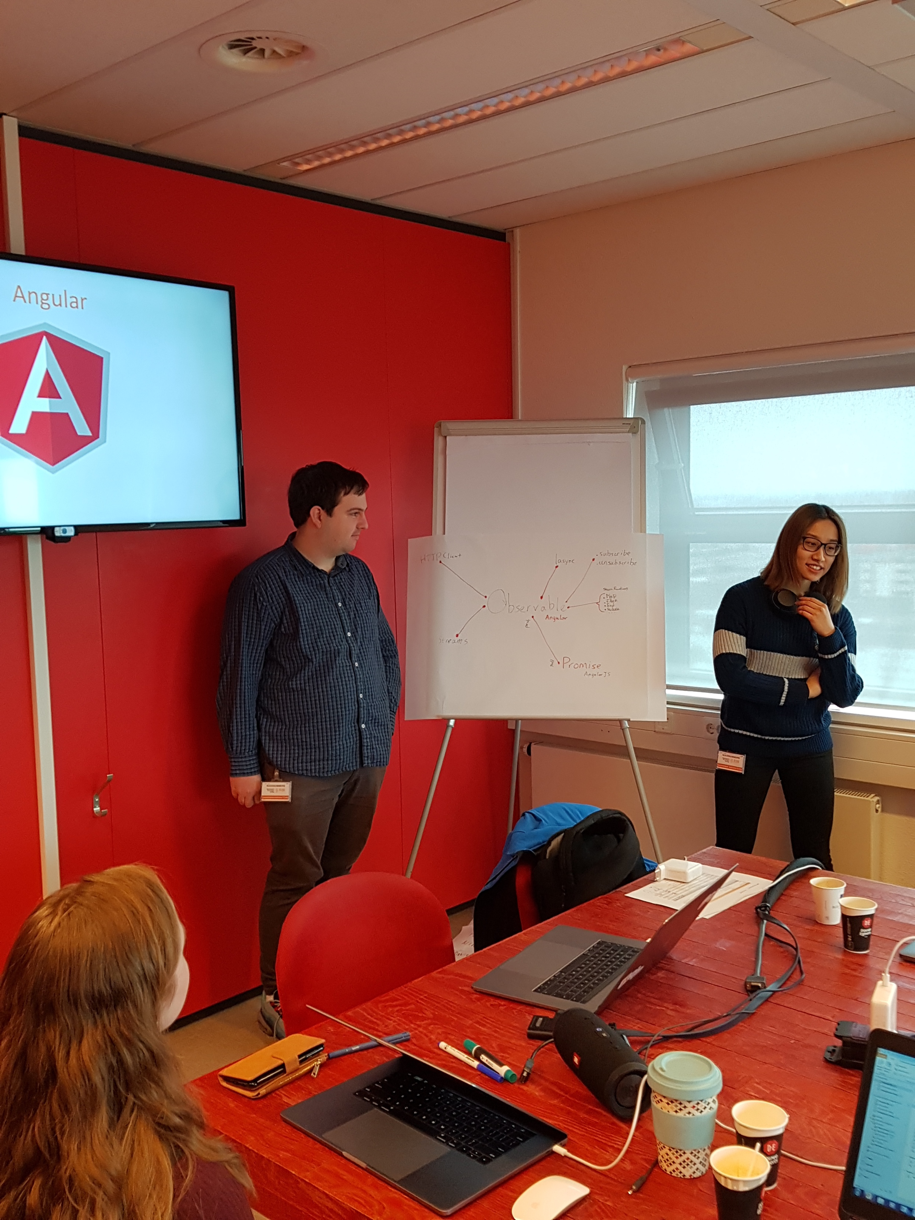

Slide 5
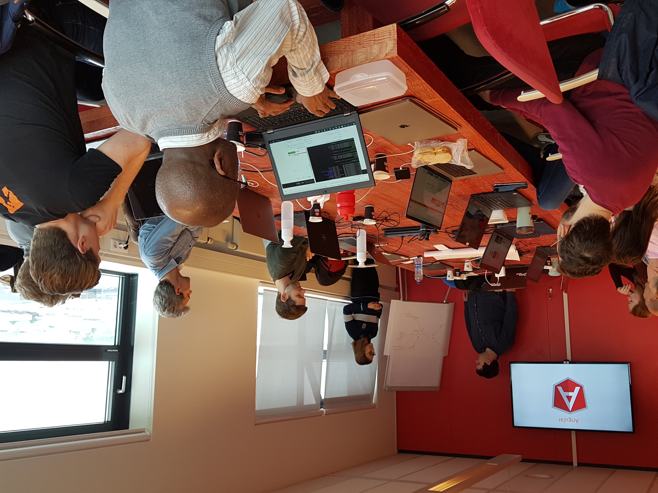

Slide 6
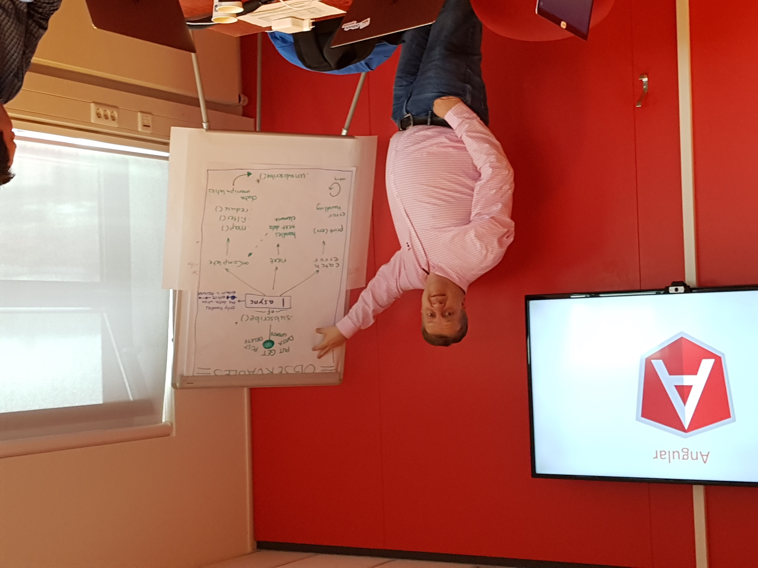

Slide 7
Components @input @output
index.html
AppComponent
app.component.html
BookSearchComponent
DashBoardComponent
BooksComponent
BookDetalsComponent
Notes:
Angular is a tree of components, because it has the same structure as your html-structure !!!
Index.html is the parent template of AppComponent ect…
AppComponent is the parent of BookComponent and …
main.ts

Slide 8
Routing – every route is a Component
Components are injected in: <router-outlet></router-outlet>
HomeComponent
<router-outlet></router-outlet>
About
Product Component
Edit Component
… Component
Component

Slide 9
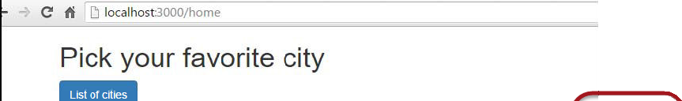
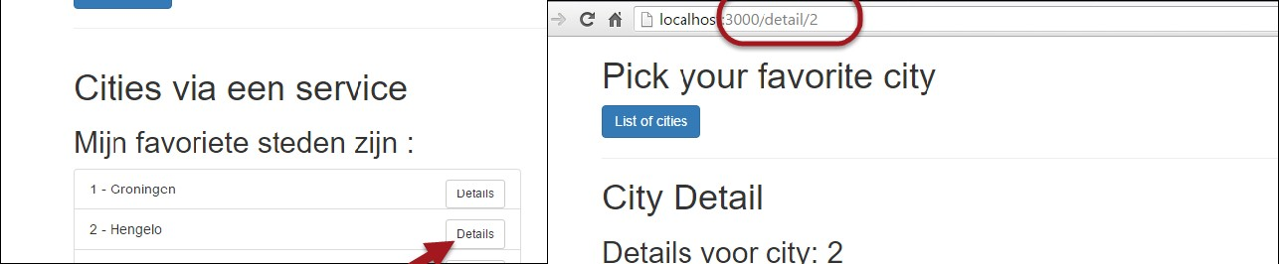

ADVANCED: Meegeven van parameters
Let op meegeven van array van parameters aan [routerLink]
Parameters worden gematched op positie. Niet op naam.
Optioneel : service uitbreiden om specifiek product/item te retourneren

Slide 11
Vandaag
Architecture
DI
Work with Live API’s
Pipes
Youtube Forms
Forms

Slide 12
Architecture Angular project
https://medium.com/@tomastrajan/6-best-practices-pro-tips-for-angular-cli-better-developer-experience-7b328bc9db81
Notes:
A good guideline to follow is to split our application into at least three different modules — Core, Shared and Feature

